Slide 1
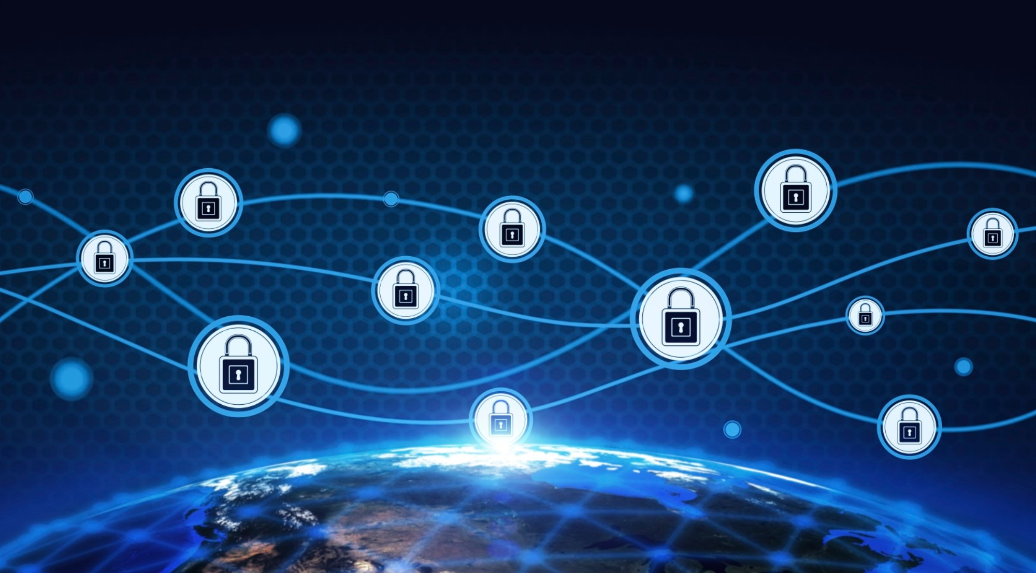
Super Secure Chat 5000
Finn Bürki
Sascha Bergmann

Slide 2
Agenda
Overlook
Technologies
Demonstration
Whats left to do
Possible Extensions
Q&A

Slide 3








Overlook
HMAC
AES
RSA

Slide 4
Remote Login
Tag
Username
S / C
JWT

Slide 5




Technologies
Client
Java 8
Swing GUI
Server
Java 8
Maven
Spring Boot REST Server
Hibernate Database Connection

Slide 6
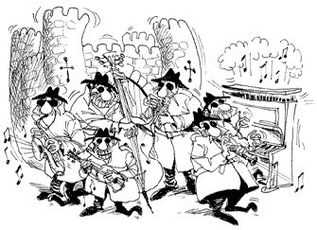
Technologies – Security Provider
Bouncycastle Framework
Cryptography API
Java
C#
Provides
Hashing
Encryption/Decryption with RSA, AES and more
Key generation

Slide 7
Features implemented
End-to-End Chat
Message encryption with AES
Integrity tag generated with HMAC with SHA 256
Key encryption with RSA
Connection secured with SSL
Remote Login
Client-side input validation

Slide 8
Demo

Slide 9
Project in Numbers
Repositories in MBytes: 103.47 Mb
Days worked on the project: 90 Days
Lines of code: 2090 (Java)
Commits: 27

Slide 10
Whats left to do
Input validation on server side
Unit Testing
Exception handling
Server logging

Slide 11
Thank you for your attention!

Slide 12
Q&A

